Slide 1


Slide 2
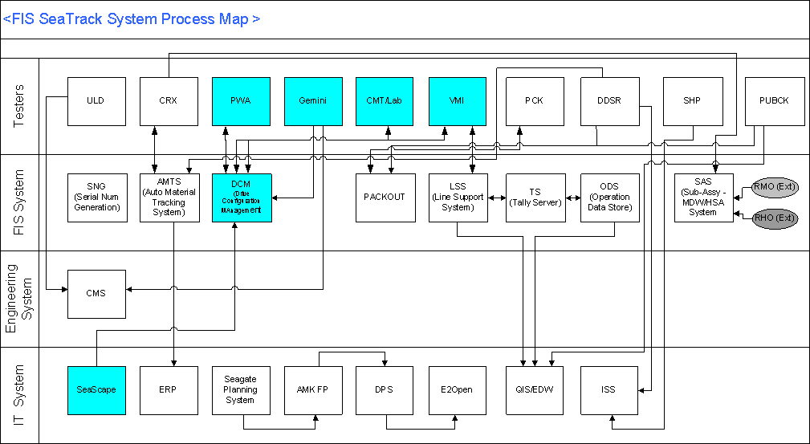
SeaTrack System Process Map Overview
DCM system Interfaces to key drive business process highlighted in blue
11/07/26
DCM Trainings
Page <number>

Slide 3
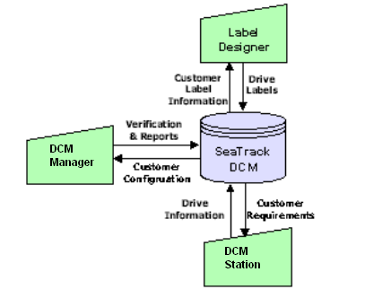
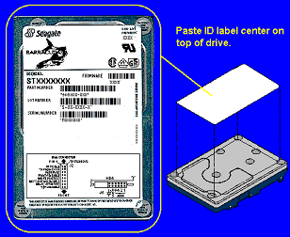
DCM : Drive Configuration Management
DCM Control
  Build control based on demand priority
  Configuration based on specific customer requirements
  Label printing control
System Architecture :
11/07/26
DCM Trainings
Page <number>

Slide 4
DCM tables
Production Tables
Engineering Tables
Customer Configuration Management Tables
Reports Tables

Slide 5
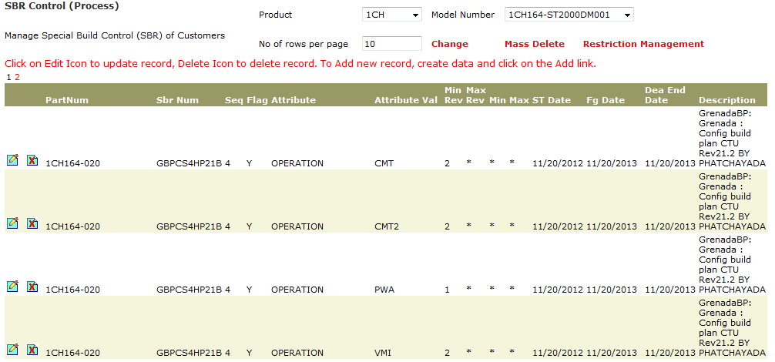
SBR Control
Can control only SBR Num

Slide 6
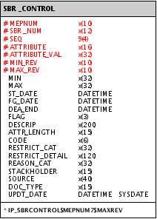
SBR_CONTROL
Table Description:
This table contains the SBR records for shiphold control by Product, Model or CC. It uses ‘Flag’ (Y/N/A/R) for allowable or block control
and uses SBR number (or *) to group data
Table Structure:
Data Input: Manually using DCMHUB
Configuration:
Applications: DCMHUB, AutoPWA/Label, Seacom, EDCC, AutoCommit

Slide 7
Check Blocking on SBR_Control:
SBR drive define by the attribute name “SUB_BUILD_GROUP”
Process Control with SBR or Non SBR
VALUE_ID FAM_GRP DATA_LIST DESCRIP
IDE_SBR_PREFIXS * SB,SS,CA Desktop SBR prefix list
SBROPER * PWA,CMT,VMI ShipHold Operation/s
Fail
SBR control on SBR drives
Prompt error messages and stop processing
Pass
Fail
SBR control on NON SBR drives
Pass
SBR control record for SBR drive with SBR number SBSG2314
MepNum Seq SbrNum Attribute Attribute_Value Flag
9SM160-004 1 SBSG2314 HDA_CODE 73582115 Y
SBR control record for NON SBR drive, which will apply to all drives build to 9SM160-004
MepNum Seq SbrNum Attribute Attribute_Value Flag
9SM160-004 1 * HDA_CODE 73582115 Y

Slide 8
Check Blocking on SBR_Control:
Process Control with Part_Num,Model,Family and flags
  By part number eg 9RZ126-001
  By Model . Eg 9RZ126-XXX
  By family. Eg 9RZXXX-XXX
  In the order CC--→ Model ---→ Family
  “Y” – Accept condition
  “N” – Reject condition
  “R” – Reject if the name attribute is present in seatrack
  “A” – Accept only if the name attribute present in seatrack

Slide 9
SBR Control Mechanism
Flag = Y
Example: Single sequence control with SBR SBSG5414 using FLAG=Y for 9RZ126-001.
A drive with ‘SBSG5414’ need to match all 4 attributes and values to PASS, any mismatch will FAIL.
MepNum Seq SbrNum Attribute Attribute_Value Flag Min_Rev Max_Rev
9RZ126-001 1 SBSG5414 HDA_CODE 73582115 Y 1
9RZ126-001 1 SBSG5414 PCBA_PART_NUM 85914 Y 1
9RZ126-001 1 SBSG5414 SCSI_CODE 0012 Y 1
9RZ126-001 1 SBSG5414 SERVO_CODE 5417 Y 1
9RZ126-001 1 SBSG5414 OPERATION PWA Y 2
9RZ126-001 1 SBSG5414 OPERATION CMT Y 1
9RZ126-001 1 SBSG5414 OPERATION VMI Y 1
Example: Single sequence control with non SBR ‘*’ using FLAG=Y for 9RZ126-001.
A drive with ‘*’ need to match all 4 attributes and values to PASS, any mismatch will FAIL.
MepNum Seq SbrNum Attribute Attribute_Value Flag Min_Rev Max_Rev
9RZ126-001 1 * HDA_CODE 73582115 Y 1
9RZ126-001 1 * PCBA_PART_NUM 85914 Y 1
9RZ126-001 1 * SCSI_CODE 0012 Y 1
9RZ126-001 1 * SERVO_CODE 5417 Y 1
9RZ126-001 1 * OPERATION PWA Y 2
9RZ126-001 1 * OPERATION CMT Y 1
9RZ126-001 1 * OPERATION VMI Y 1
If a drive PASS (matching all attributes in the same sequence) at one level (9RZ126-001),
it will proceed to next 2 levels of checking (model 9RZ126-000, family level 9RZ000-000).
If there’s no record control for all 3 level, the drive will PASS the control.

Slide 10
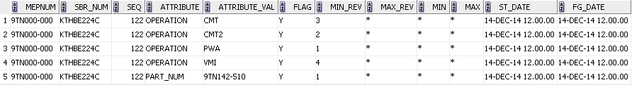
Example: Single sequence control with SBR KTHBE224C using FLAG=Y for 9TN000-000.
  A drive with ‘KTHBE224C’ allow for PART_NUM 9TN142-510
  A drive PART_NUM 9TN142-510 allow with ‘KTHBE224C’ only.
9TN000-000
Y

Slide 11
Flag = N
Example: Single sequence control with SBR SBSG4414 using FLAG=N for 9RZ126-001.
A drive with ‘SBSG4414’ matches all 4 attributes and values will FAIL, any mismatch will have the drive PASS.
MepNum Seq SbrNum Attribute Attribute_Value Flag Min_Rev Max_Rev
9RZ126-001 1 SBSG5414 HDA_CODE 73582115 N 1
9RZ126-001 1 SBSG5414 PCBA_PART_NUM 85914 N 1
9RZ126-001 1 SBSG5414 SCSI_CODE 0012 N 1
9RZ126-001 1 SBSG5414 SERVO_CODE 5417 N 1
9RZ126-001 1 SBSG5414 OPERATION PWA N 2
9RZ126-001 1 SBSG5414 OPERATION CMT N 1
9RZ126-001 1 SBSG5414 OPERATION VMI N 1
MepNum Seq SbrNum Attribute Attribute_Value Flag Min_Rev Max_Rev
9RZ126-001 1 * HDA_CODE 73582115 N 1
9RZ126-001 1 * PCBA_PART_NUM 85914 N 1
9RZ126-001 1 * SCSI_CODE 0012 N 1
9RZ126-001 1 * SERVO_CODE 5417 N 1
9RZ126-001 1 * OPERATION PWA N 2
9RZ126-001 1 * OPERATION CMT N 1
9RZ126-001 1 * OPERATION VMI N 1
If a drive FAIL (matching all attributes in the sequence) at one level, it will not proceed to next 2 levels of checking (model, family level)

Slide 12
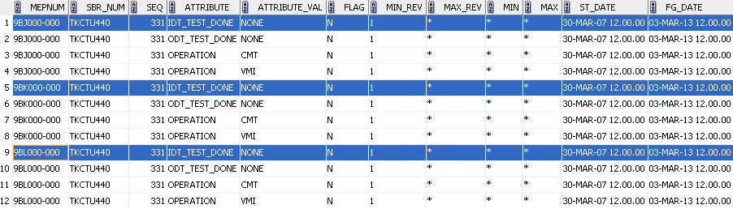
Example: Single sequence control with SBR KTHBE224C using FLAG=N for 9GW000-000.
  A drive with ‘KTHBE224C’ not allow for PART_NUM 9GW000-000 (9GW%).
Example: Single sequence control with SBR TKCTU440 using FLAG=N for 9BJ000-000.
  A drive with ‘TKCTU440’ not allow for PART_NUM 9BJ000-000 (9BJ%) with
  IDT_TEST_DONE = NONE
  ODT_TEST_DONE = NONE

Slide 13
Flag = A
Example: Single sequence control with SBR SBSG5414 using FLAG=A for 9RZ126-001.
A drive with ‘SBSG5414’ need to match all 4 to PASS, any mismatch will FAIL.
MepNum Seq SbrNum Attribute Attribute_Value Flag Min_Rev Max_Rev
9RZ126-001 1 SBSG5414 HDA_CODE * A 1
9RZ126-001 1 SBSG5414 PCBA_PART_NUM * A 1
9RZ126-001 1 SBSG5414 SCSI_CODE * A 1
9RZ126-001 1 SBSG5414 SERVO_CODE * A 1
9RZ126-001 1 SBSG5414 OPERATION * A 2
9RZ126-001 1 SBSG5414 OPERATION * A 1
9RZ126-001 1 SBSG5414 OPERATION * A 1
MepNum Seq SbrNum Attribute Attribute_Value Flag Min_Rev Max_Rev
9RZ126-001 1 * HDA_CODE * A 1
9RZ126-001 1 * PCBA_PART_NUM * A 1
9RZ126-001 1 * SCSI_CODE * A 1
9RZ126-001 1 * SERVO_CODE * A 1
9RZ126-001 1 * OPERATION * A 2
9RZ126-001 1 * OPERATION * A 1
9RZ126-001 1 * OPERATION * A 1
If a drive PASS (matching all attributes in the same sequence) at one level (9RZ126-001),
it will proceed to next 2 levels of checking (model 9RZ126-000, family level 9RZ000-000).
If there’s no record control for all 3 level, the drive will PASS the control.

Slide 14
Flag = R
Example: Single sequence control with SBR SBSG4414 using FLAG=R for 9RZ126-001.
A drive with ‘SBSG4414’ matches all 4 attributes FAIL, any mismatch will have the drive PASS.
MepNum Seq SbrNum Attribute Attribute_Value Flag Min_Rev Max_Rev
9RZ126-001 1 SBSG5414 HDA_CODE * R 1
9RZ126-001 1 SBSG5414 PCBA_PART_NUM * R 1
9RZ126-001 1 SBSG5414 SCSI_CODE * R 1
9RZ126-001 1 SBSG5414 SERVO_CODE * R 1
9RZ126-001 1 SBSG5414 OPERATION * R 2
9RZ126-001 1 SBSG5414 OPERATION * R 1
9RZ126-001 1 SBSG5414 OPERATION * R 1
MepNum Seq SbrNum Attribute Attribute_Value Flag Min_Rev Max_Rev
9RZ126-001 1 * HDA_CODE * R 1
9RZ126-001 1 * PCBA_PART_NUM * R 1
9RZ126-001 1 * SCSI_CODE * R 1
9RZ126-001 1 * SERVO_CODE * R 1
9RZ126-001 1 * OPERATION * R 2
9RZ126-001 1 * OPERATION * R 1
9RZ126-001 1 * OPERATION * R 1
If a drive FAIL (matching all attributes in the sequence) at one level, it will not proceed to next 2 levels of checking (model, family level)

Slide 15
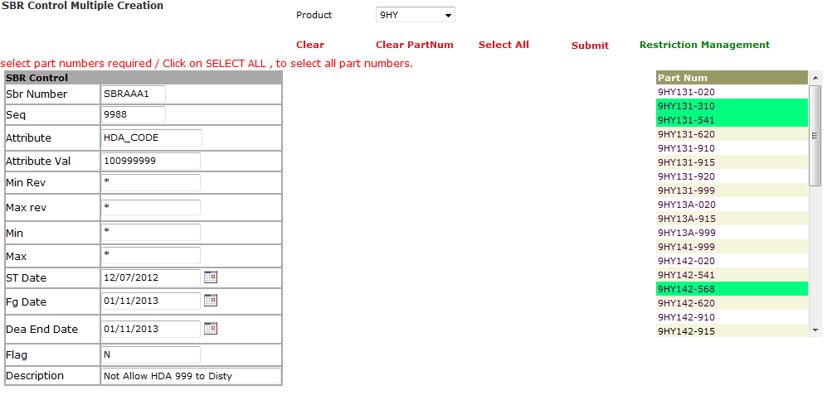
SBR Multiple Block Creation
Manually input for condition then selecting part_num as need to add in.

Slide 16
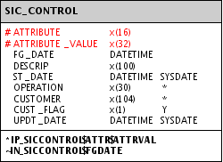

SIC_CONTROL
Table Description:
This table contains mass component screening data for blocking control
Table Structure:
Data Input: Manually using DCMHUB
Configuration:
Applications: DCMHUB, AutoPWA/Label, Seacom, EDCC, AutoCommit

Slide 17
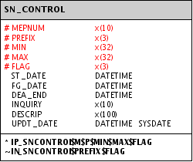
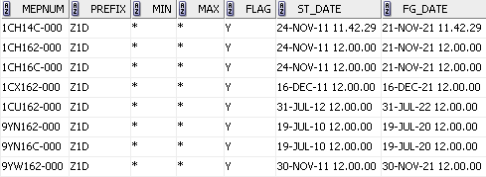
SN_CONTROL
Table Description:
This table defines drive prefix and serial number range control
Table Structure:
Data Input: Manually using DCMHUB
Configuration:
Applications: DCMHUB, AutoPWA/Label, Seacom, EDCC, AutoCommit

